Slide 1
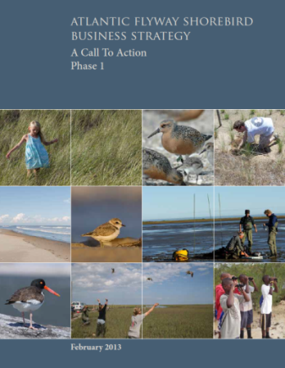
Scott Johnston USFWS – Division of Migratory Birds scott_johnston@fws.gov

Slide 2
A Case For Prioritizing Shorebird Conservation
• Shorebirds are in jeopardy within the
Atlantic Flyway:
Warrant increased conservation attention
• Atlantic Flyway Shorebird Business
Strategy can reverse declines:
Multiple partners have a timely opportunity to play a role
Notes:
Timely Opportunity to play a role: 1) Efficient and effective use of partnership network; 2) Fits well into ACJV mission

Slide 3
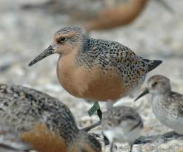
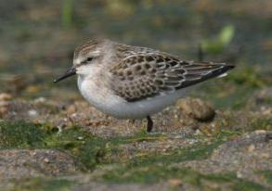
Shorebird Populations are Declining
Red
Knot
Semipalmated
Sandpiper
81%
79%
Since 2000
Since 1982
G. Breese
Winter counts -- Sources: R.I.G. Morrison; L. Niles
L. Master
Winter counts -- Source: Morrison et al. 2012

Slide 4
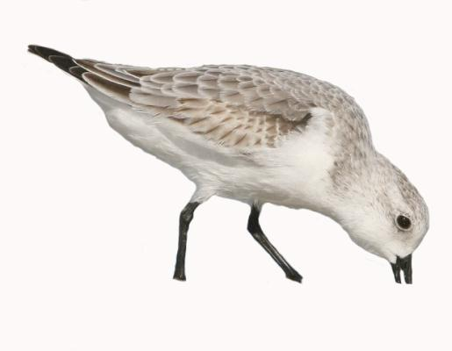
Shorebird Population Declines In the Atlantic
• Declines reported for 71%
of shorebird species
Source: Morrison et al. 2006, Andres 2009
Solitary Sandpiper
Sanderling
Marbled Godwit
Red-necked Phalarope
Dunlin
Purple Sandpiper
Red Phalarope
Buff-breasted Sandpiper
Least Sandpiper
Lesser Yellowlegs
American Golden Plover
White-rumped Sandpiper
American Woodcock
Semipalmated Sandpiper
Snowy Plover
Killdeer
Western Sandpiper
Long-billed Curlew
Pectoral Sandpiper
Willet
Wilson’s Plover
Wilson’s Snipe
Red Knot
Upland Sandpiper
Hudsonian Godwit
Whimbrel

Slide 5
Atlantic Flyway Shorebird Business Strategy - A Timely Opportunity
Goal: ↑ focal shorebird
pops. 10-15% by 2020
• Participation:>60 agencies,
NGOs, universities
• Action-oriented: projects,
funding, partners
• Flyway Scale
Notes:
Participation: all US Atlantic states, international (Canada, Caribbean); Garnered NGO support at high levels & Congressional attention/support; Interest of funders (NFWF, Audubon, etc).
Flyway Scale: Argentina N. to Arctic

Slide 6
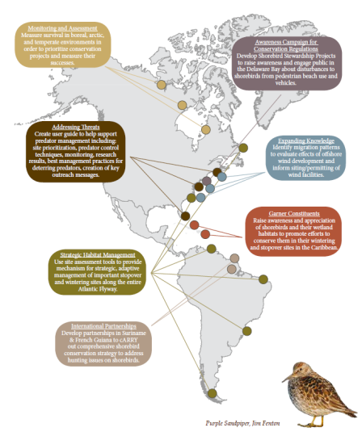
Atlantic Flyway Shorebird Business Strategy - Components
• Major Threat Categories:
Habitat Loss & Change
Human Disturbance
Predation
Hunting
Knowledge Gaps
• 15 Focal Species:
American Golden Plover
Greater Yellowlegs
Marbled Godwit
Purple Sandpiper
Red-necked Phalarope
Sanderling
Snowy Plover
Wilson’s Plover
American Oystercatcher
Lesser Yellowlegs
Piping Plover
Red Knot
Ruddy Turnstone
Semipalmated Sandpiper
Whimbrel
• Specific activities/projects
Notes:
7 Key Strategies: Activities are made up by specific projects developed by shorebird experts at NCTC -- 98 projects; Approx. $20M/yr

Slide 7
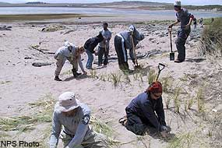
Shorebird Business Strategy – based on American Oystercatcher
• Measurable Objectives - $ for increased
population growth/reduced mortality
• Process of full engagement
of partners
• Funding and fundraising –
key parts of Strategy
• Cumulative conservation impact -
leverage partners & resources
Notes:
Phase 1: Phase 1 is mostly North America w/ many projects centered in US - Plans for a US Atlantic focal document …Phase 2 = Caribbean; Phase 3 = South America -- workshops this summer at international meetings
Coastal & wetland focus: Other ACJV focal species including waterbirds, seabirds, and some songbirds

Slide 8
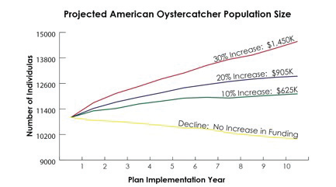

Slide 9
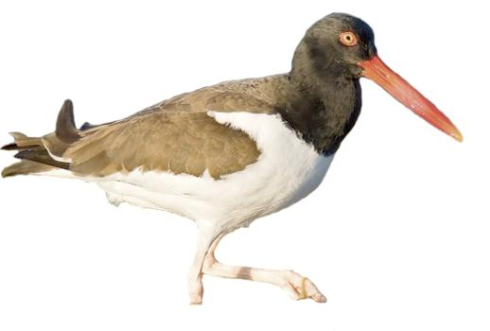
Next Steps
• Help lead/encourage partnerships to
meet conservation goals
• Establish strategic partnerships –
SCSCB and WHSG meetings
NFWF to fund hunting work in Caribbean
• Adoption of Business
Strategy by NFWF
as Keystone Initiative
Notes:
Lead/encourage partnerships - Aim to develop 1-2 new partnerships per year to support specific Shorebird Strategy objectives;
Facilitate efficient conservation - helping to coordinate resources for specific objectives – eliminating duplicative efforts

Slide 10
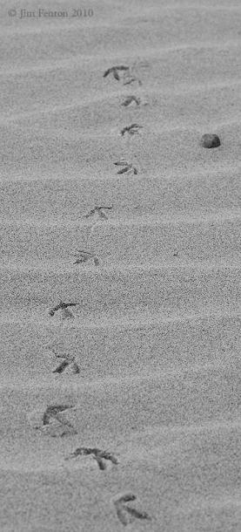
Next Steps
• Sandy funding
leverages NFWF
• Using Open Standards to
refine projects/outcomes
• Lack of appreciation by
public or political entities,
includes “outreach”

